Slide 1
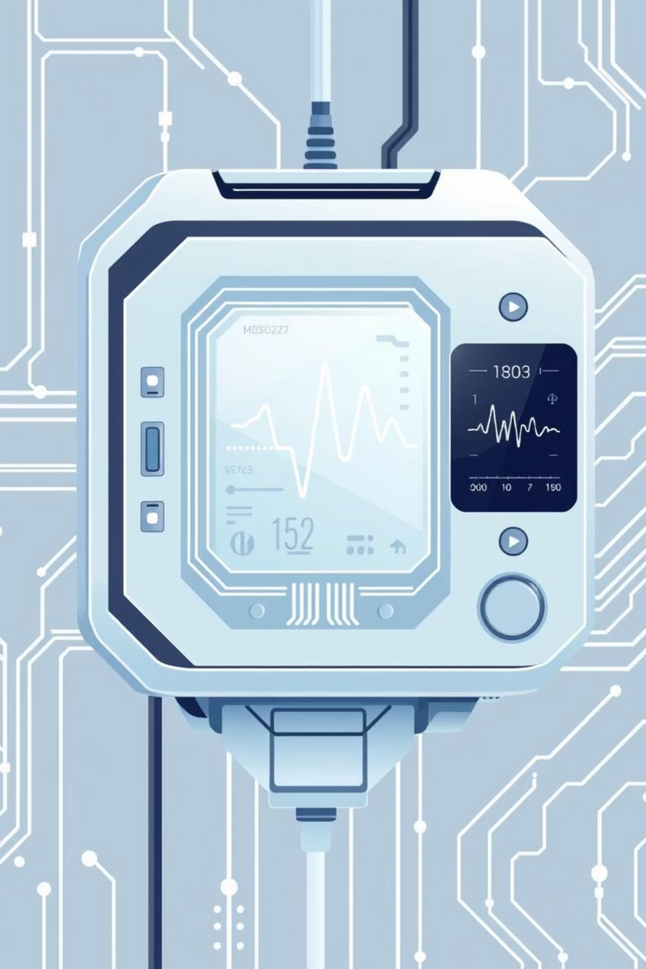

Edge Intelligence for Medical Diagnostics using FPGA & AI
A Lightweight & Real-Time Healthcare Revolution
Notes:
1

Slide 2












What Ties All the Research Together?
Our research explores the transformative potential of integrating Edge Intelligence with Field-Programmable Gate Arrays (FPGAs) and Artificial Intelligence (AI) to revolutionize medical diagnostics. This approach focuses on real-time, low-power solutions directly at the point of care.
Medical Diagnosis with Edge Intelligence
Breast Cancer Detection
Ultrasound + CNN on FPGA
Multimodal IoMT System
Heart Sound Segmentation
Audio, Text, Image + DNN
PCG + FPGA, Real-time
Handheld Ultrasound
Parkinson's Detection
FPGA + SAI, Portable
Voice + ML, Low-power
Notes:
2

Slide 3
Comparing the Core Technologies
A comparative overview of the underlying technologies across various research papers highlights their unique contributions to the field of edge-AI healthcare.
Problem Addressed
Input Modality
Processing Unit
Hardware
Real-time?
Target Use Case
Breast Cancer
Ultrasound
CNN
FPGA
✅
Mobile Clinics
Heart Sound Seg.
PCG Audio
DSP Algorithm
FPGA
✅
Wearable Devices
Parkinson's Det.
Voice
ML Model
Android/Edge
✅
Home Monitoring
Handheld Ultrasound
Ultrasound
SAI (AI)
FPGA
✅
Rural Areas
Multimodal IoMT
Audio, Text, Image
DNN
SoC (System on Chip)
✅
Remote Diagnosis
Notes:
3

Slide 4




Typical Edge-AI Healthcare Pipeline
This generalized pipeline illustrates how various medical data modalities are processed from sensor input to intelligent output, leveraging edge AI and FPGA capabilities for efficient and timely diagnostics.
Sensor/Input
Preprocessing on FPGA
CNN / ML Model
Voice, Ultrasound, PCG
Noise reduction, feature extraction
On-device inference
4
Output to Mobile / Screen
Cloud Feedback (Optional)
Real-time results
Data aggregation, model updates
Notes:
4

Slide 5




Key Learnings & Future Scope
Key Takeaways
What’s Next
FPGA = Low Power + Real-Time: Essential for portable and resource-constrained medical devices.
Edge AI Efficiency: CNN/ML models can run on edge devices with effective compression techniques.
Add Security Modules
Accessible Healthcare: AI solutions enable reliable diagnosis even in low-resource environments.
Portability is a Game-Changer: Enhances diagnostic reach and patient convenience.
Explore LSTM / Transformer blocks for complex data
Train on Diverse Regional Data
Optimize with TinyML for even smaller footprints
Notes:
5

Slide 6



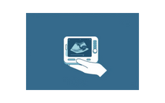

Summary & What This Means
The integration of Edge AI and FPGA technologies promises to democratize healthcare by making advanced diagnostics more accessible and efficient.
“Edge AI + FPGA enables affordable, fast, and reliable diagnosis for all — from urban hospitals to rural clinics.”
Thank You
Praveen Kumar
Notes:
6

Slide 7
Lightweight FPGA-based Medical Image Classifiers
This paper presents a practical approach to medical image classification using low-cost FPGA boards. The researchers designed and implemented three lightweight binary classifiers - k-Nearest Neighbors (k-NN), Convolutional Neural Network (CNN), and Decision Tree (DT) - targeting small-sized medical images, with a focus on malaria detection from blood cell images.
The key highlights include:
1
High Accuracy
2
Low Hardware Utilization
3
Significant Speedup
The classifiers achieved FPGA accuracy up to 99.33% (Decision Tree), with only slightly lower accuracy compared to MATLAB simulations.
The Decision Tree classifier required the lowest FPGA resources, with up to 96.7% reduction in LUT usage compared to prior works.
The FPGA implementations provided over 1000x speedup compared to the MATLAB software versions.
This work demonstrates the potential of deploying affordable, real-time medical diagnostic tools in resource-constrained environments using low-cost FPGA platforms.
Notes:
7

Slide 8
Lossless Video Compression for High-Resolution Industrial Cameras
This research presents a novel, high-speed, and low-resource lossless compression algorithm designed for transmitting high-resolution video streams (e.g., 4K+) from industrial cameras over USB 3.0 interfaces. The key focus is on enabling real-time, efficient data compression in hardware using FPGA technology.
1
Compression Technique
2
Parallel Processing
3
Performance Highlights
The algorithm utilizes inter-pixel redundancy by transmitting the differences between adjacent pixels (delta encoding) instead of raw pixel values, reducing the overall data size.
The innovative "First-In, Last-Out" (FILO) data inversion structure allows parallel processing of 4 channels simultaneously, maintaining real-time throughput while reducing FPGA resource usage.
The solution achieves up to 50.02% compression ratio, 18.3 fps post-compression frame rate, and over 40% decompression speed boost compared to traditional methods.
This work addresses the growing need for real-time, lossless compression of high-resolution video in industrial and scientific imaging applications, where image fidelity is critical and USB 3.0 bandwidth can be a bottleneck. The FPGA-based implementation ensures high throughput, low resource utilization, and significant speed-up in both transmission and decompression.
Notes:
8

Slide 9
NLU: An Adaptive, Small-Footprint, Low-Power Neural Learning Unit for Edge and IoT Applications
1
Motivation
2
Key Innovations
3
Hardware Integration
Online training of deep neural networks (DNNs) on edge devices offers advantages like adaptability, personalization, and privacy, but is challenging on resource-restricted devices.
The NLU incorporates a dynamic control unit, tile allocation engine, and neural compute pipeline to enhance data reuse and flexibility.
The NLU was integrated into a 32-bit RISC-V SoC, occupying just 0.015mm² and consuming only 0.379mW.
4
Performance
The NLU can accelerate training by up to 24.38× and reduce energy by up to 37.37× compared to a RISC-V with FPU, making it well-suited for edge and IoT applications.
Notes:
9

Slide 10
Real-Time Classification of Vehicles Using Machine Learning Algorithm on the Extensive Dataset
1
Objective
2
Motivation
3
Proposed Approach
To design a real-time, accurate, and robust system for vehicle classification using machine learning on large and complex image datasets, and implement it on an FPGA for high-speed performance.
Manual vehicle classification is error-prone and slow. Many existing ML-based systems fail under poor lighting, occlusion, and weather conditions. There's a need for a fast, accurate, and real-time solution for applications like traffic monitoring and smart city systems.
The system uses Random Wavelet Transform for preprocessing, combines edge-based and region-based segmentation, employs embedded feature selection, and uses XGBoost for final classification. It is implemented on an FPGA for real-time execution.
4
Datasets
5
Results
10 publicly available datasets were used, along with a new custom dataset called SRM2KTR with 75,436 images under challenging real-world conditions.
The system achieves 98.81% accuracy, outperforming previous state-of-the-art, and can classify vehicles in 0.16 nanoseconds per image on the FPGA.
Notes:
10

Slide 11
Further Reading & References
To delve deeper into the foundational research and innovative projects discussed, here are key academic publications and their contributing authors.
Medical Diagnostics & Edge AI
Specialized Applications & Hardware
"Portable and Cost-Effective Handheld Ultrasound System Utilizing FPGA-Based Synthetic Aperture Imaging"W. Wang & Z. Feng, Sichuan University.
"NLU: An Adaptive, Small-Footprint, Low-Power Neural Learning Unit for Edge and IoT Applications"
"Real-Time Classification of Vehicles Using Machine Learning Algorithm on the Extensive Dataset"
"Low-Cost FPGA Implementation of Deep Learning-Based Heart Sound Segmentation for Real-Time CVDs Screening"D. Enériz et al., IEEE, Spain.
"An FPGA Prototype for Parkinson’s Disease Detection Using Machine Learning on Voice Signal"M. Khan et al., Aligarh Muslim University, Bennett University.
"FPGA SoC Implementation of Adaptive Deep Neural Network based Multimodal Edge Intelligence for Internet of Medical Things"N. B. Gaikwad et al., Aalborg University, University of Southern Denmark.
"A Lightweight Deep Convolutional Neural Network Implemented on FPGA and Android Devices for Detection of Breast Cancer Using Ultrasound Images"A. Vinod et al., Birla Institute of Technology and Science.
"Hardware Design of Lightweight Binary Classification Algorithms for Small-Size Images on FPGA"S. Saglam & S. Bayar, University of Southampton, Marmara University.
"Project Prana: Digital Olfaction System-on-Chip"
Our innovative projects, "Project Sentinel: Eco-Acoustic Monitoring" and "The Critical Path: Neurological Co-processor Development," are inspired by critical global challenges highlighted by the UN Sustainable Development Goals (SDG 14: Life Below Water & SDG 15: Life on Land) and The World Health Organization & The Lancet Commission on global mental health and neurological disorders.
Notes:
15

Slide 12


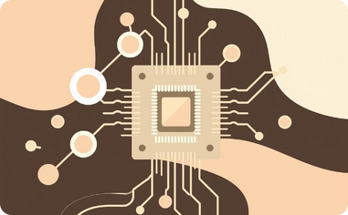
Exploring New Horizons: Our Innovative Projects
Beyond our core research, we are actively developing groundbreaking projects that push the boundaries of edge intelligence in healthcare and environmental monitoring. These initiatives leverage our expertise in FPGAs and AI to address critical real-world challenges.
The Critical Path: Neurological Co-processor Development
Project Sentinel: Eco-Acoustic Monitoring
Project Prana: Digital Olfaction System-on-Chip
Revolutionizing brain-computer interfaces with dedicated co-processing units for real-time neural data analysis.
Utilizing advanced acoustic sensors and AI for real-time biodiversity monitoring and environmental health assessment.
Developing compact, intelligent systems capable of 'smelling' and analyzing complex chemical signatures for diagnostic applications.
Notes:
11

Slide 13
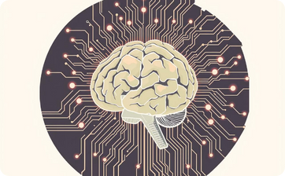


The Critical Path: Neurological Co-processor Development
Our strategic analysis identifies key pathways for developing a real-time, low-power co-processor for decoding neurological biomarkers, focusing on accelerated clinical impact.
Hardware-Algorithm Co-Design
Clinical Biomarker Validation
Regulatory & Ethical Compliance
Develop heterogeneous ASICs with advanced architectures for real-time processing, leveraging Quantization-Aware Training and Hardware-Aware NAS.
Conduct rigorous, parallel clinical research to validate multi-modal biomarkers (vocal, motor, cognitive) across diverse patient populations.
Adhere to stringent FDA medical device regulations, ensuring privacy-by-design through on-device processing and federated learning.
Notes:
12

Slide 14

Project Sentinel: Eco-Acoustic Monitoring
This initiative proposes deploying thousands of low-cost, autonomous sentinel devices for real-time ecosystem monitoring, combining ultra-low-power hardware with on-device AI.
Four Core Pillars:
Microwatt-Power SoC: Event-driven hardware for extreme power conservation.
On-Device AI Brain: Lightweight CRNN for species & threat identification.
Global LPWAN Network: LoRaWAN for remote, low-power data transmission.
Event-Driven Data Platform: Scalable cloud for real-time insights.
Development Roadmap (Phased):
1
2
3
4
SoC & AI Co-Design
Prototype & Field Validation
Pilot Network Deployment
Scaling for Global Impact
De-risk core tech, develop/benchmark AI, verify on FPGA.
Manufacture, test, and deploy initial prototypes in controlled environments.
Partner with conservation groups for real-world deployment (1,000 units).
Mass production, "Sentinel Kit," and data platform expansion.
Notes:
13

Slide 15

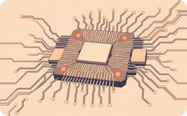
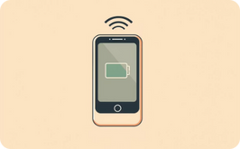

Project Prana: Digital Olfaction System-on-Chip
Project Prana aims to grant machines a digital sense of smell using a Digital Olfaction System-on-Chip (SoC) for instantaneous diagnostics.
The Digital Olfaction Imperative
The Core Invention: Prana SoC
Execution Blueprint & Roadmap
Strategic Recommendations
Leveraging Volatile Organic Compounds (VOCs) as chemical fingerprints for early cancer detection, metabolic disorder monitoring, food safety, and environmental analysis.
An SoC integrating high-sensitivity multi-channel sensor interfaces, a power-efficient neuromorphic core (SNNs), and on-chip self-calibration for sensor-agnostic support (MOS, CP sensors).
A "Data-First" approach building a "Scent-Print" library, focusing on a "Platform, Not Product" strategy with low-cost, battery-powered handheld devices and an event-driven data pipeline.
Embrace a platform model via SoC licensing and APIs, prioritize the "data moat" by continuously enriching the Scent-Print library, and lead with a high-impact application for undeniable value.
Notes:
14

